Slide 1

Task 20
Basic and Advanced Data Manipulation with NumPy
Name: Basel Amr Barakat
Email: baselamr52@gmail.com

Slide 2
Requirement One
Creating and Manipulating NumPy Arrays.

Slide 3
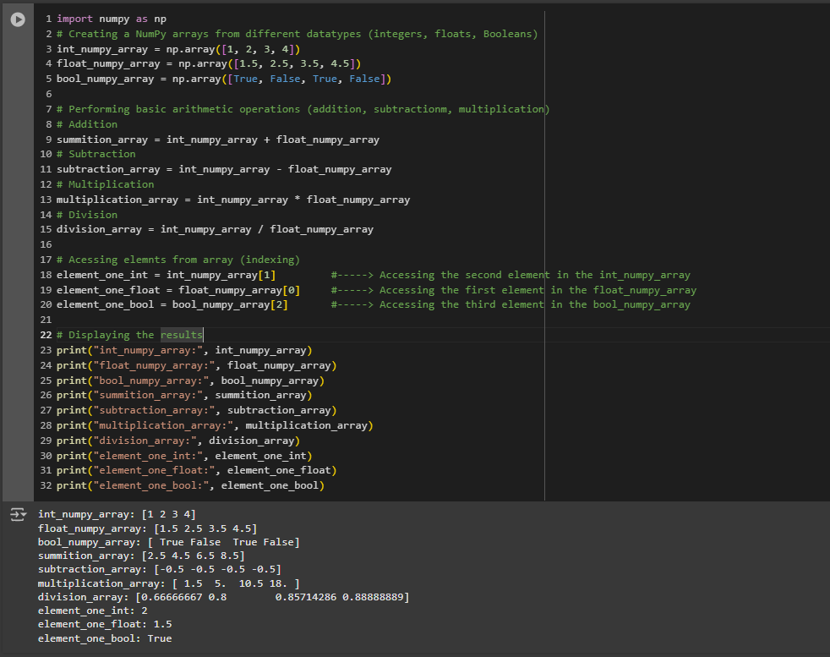

Slide 4
Requirement Two
Advanced Array Manipulation.

Slide 5
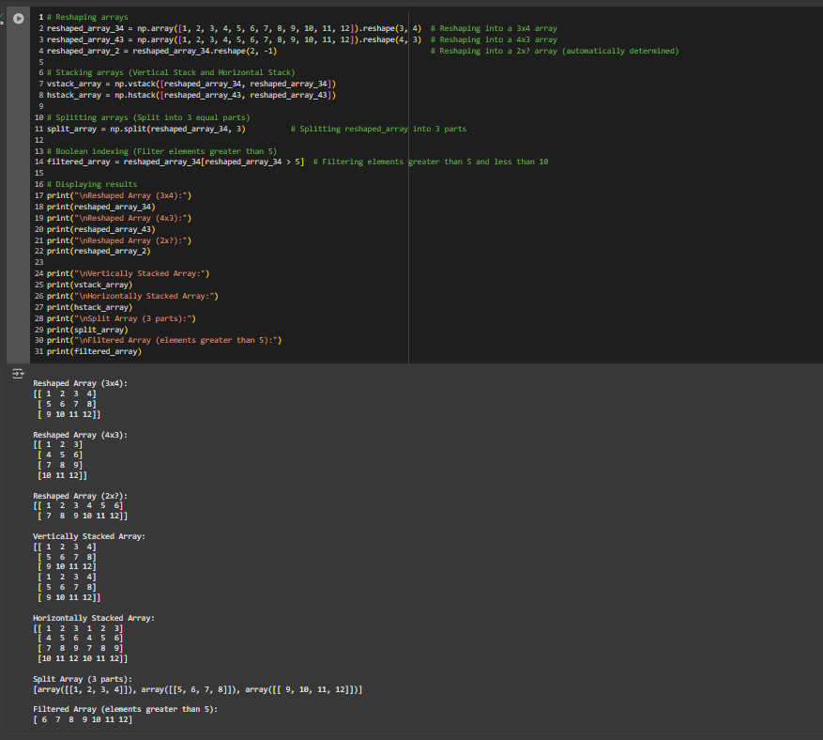

Slide 6
Requirement Three
Mathematical and Statistical Operations..

Slide 7
